Slide 1


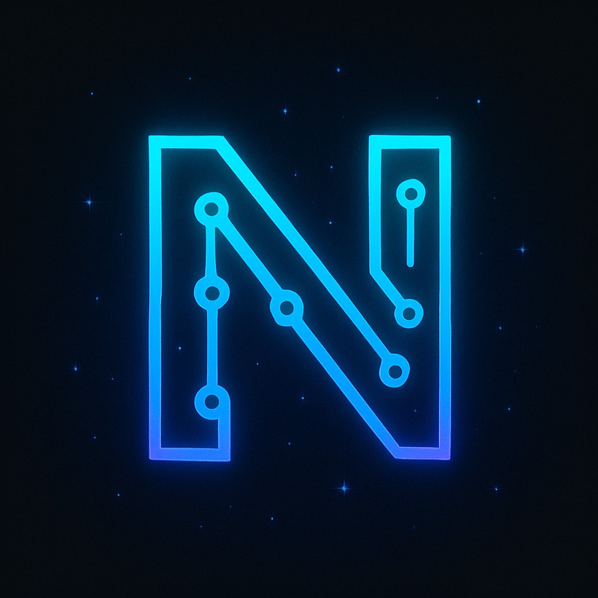

MINOR
Project

Slide 2

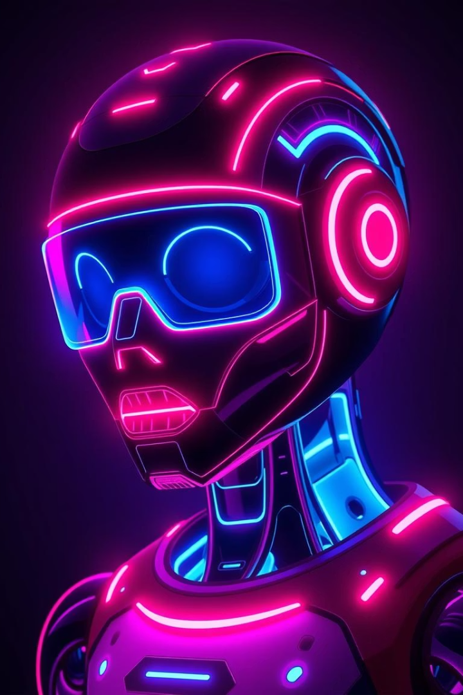

Neo Nova –
A Futuristic AI Chatbot
Introducing Team 2CSE1 from IILM University, 4th Semester B.Tech Artificial Intelligence branch.
Team Leader: Aditya Sahani.
Members: Mudit Agrawal, Nikhil Raghav, Parshant Vashisht.
Notes:
1

Slide 3

Project Overview:
Purpose
Technology
Interaction
Assist students with academic and general queries.
Uses NLP and real-time search APIs.
Smart, conversational AI experience.
Notes:
2

Slide 4
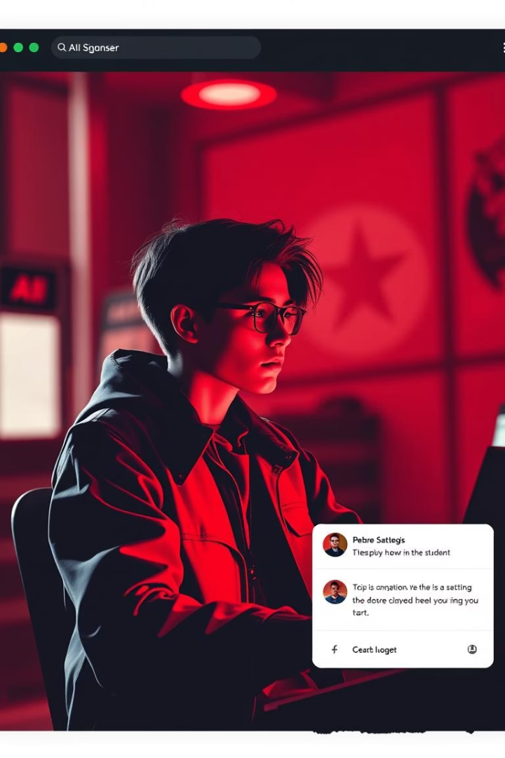
Project Objectives:
Intelligent support
Real-time answers
For academic progress.
For general student queries.
Fast, simple interface
Accessible via browser.
Notes:
3

Slide 5
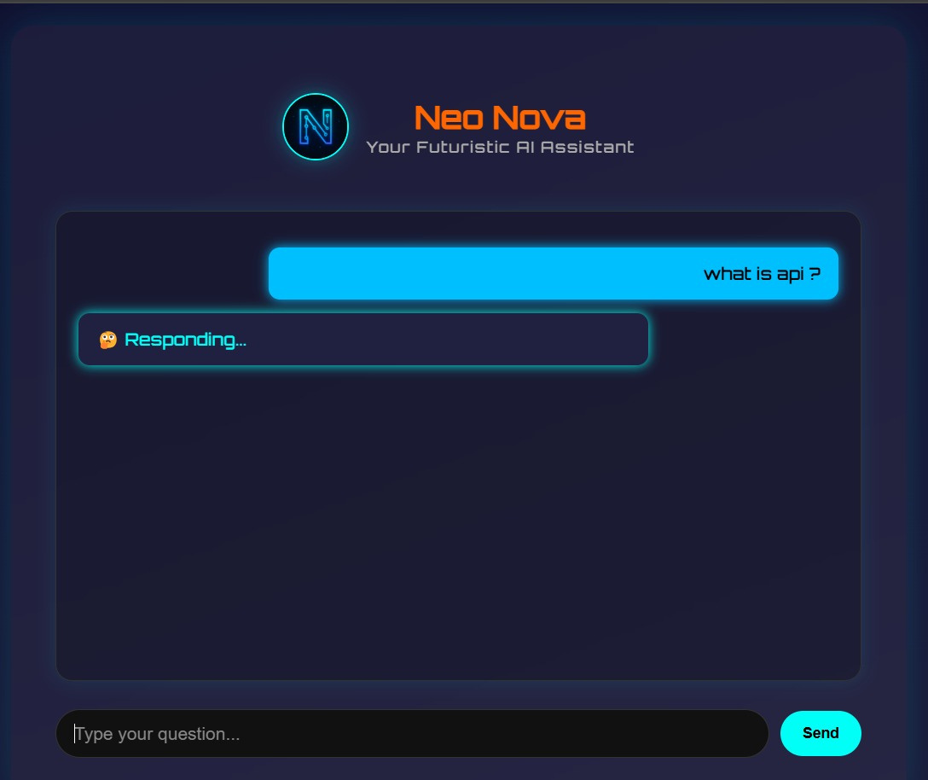

FRONT VIEW OF NEO NOVA APPLICATION

Slide 6
Tools & Technologies:
Frontend
Backend & APIs
Development IDE
HTML
Python (Flask)
Visual Studio Code (VS Code)
CSS
Dialogflow
JavaScript
Gemini API
Google APIs (Search, CX)
Notes:
4

Slide 7
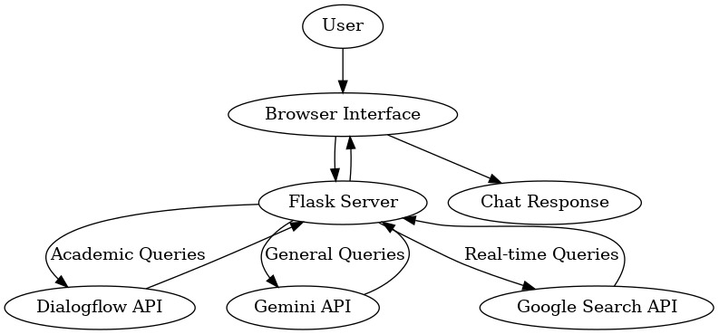
System Architecture:
Notes:
5

Slide 8
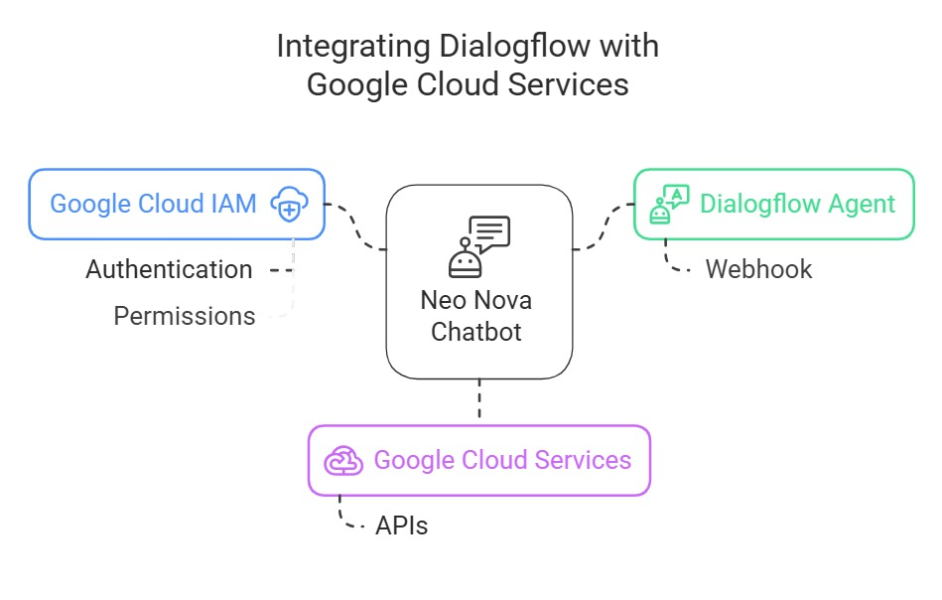
Integrating Dialogflow with Google Cloud Services :

Slide 9





Key Chatbot Features:
Natural Language
Real-Time Updates
Student Focus
Browser-Based
Understands student queries
Time, date, web info
Class schedule & academic help
Lightweight, accessible
Notes:
6

Slide 10
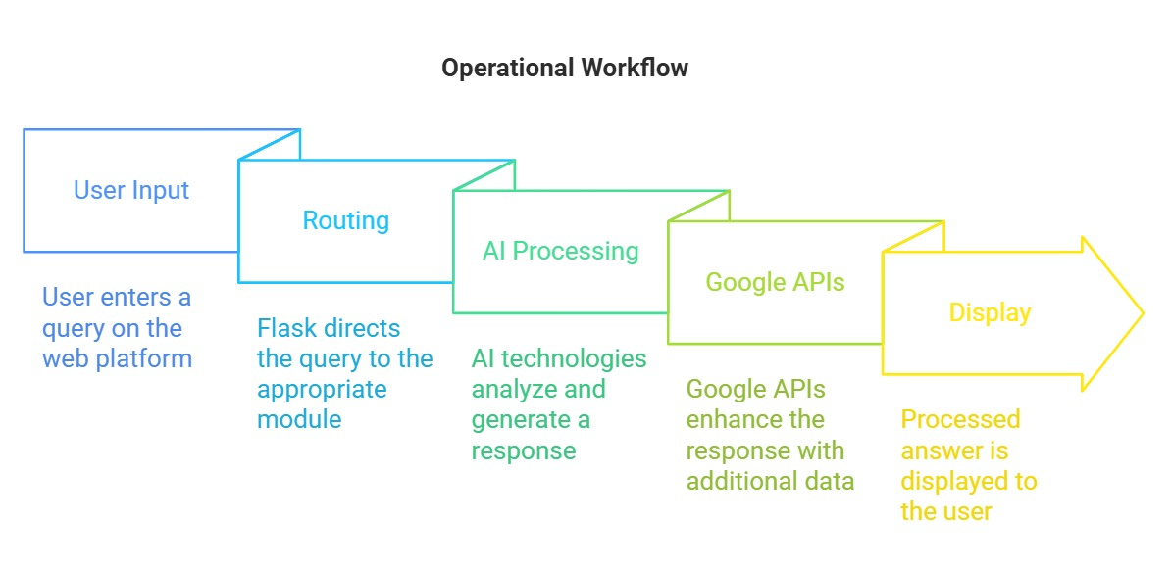
Operational Workflow:
Notes:
7

Slide 11
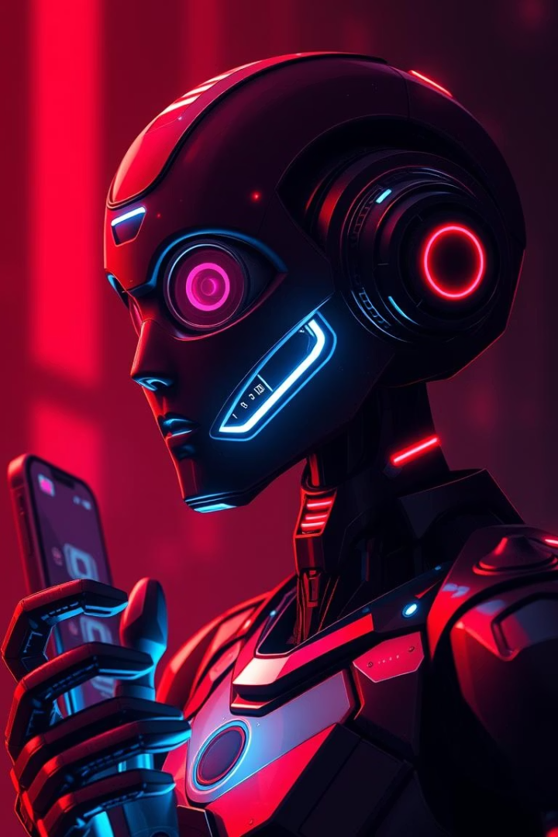




Future Development:
1
Student Profiles
Personalized info delivery
2
Voice Assistant
Hands-free interactions
3
Mobile Deployment
On-the-go access
4
Push Notifications
Reminders and alerts
Notes:
8

Slide 12

Project Learnings:
Python Backend
API Integration
Development and deployment skills
Handling real-time data
Teamwork
AI Education
Collaboration and version control
Applying AI in academic tools
Notes:
9

Slide 13
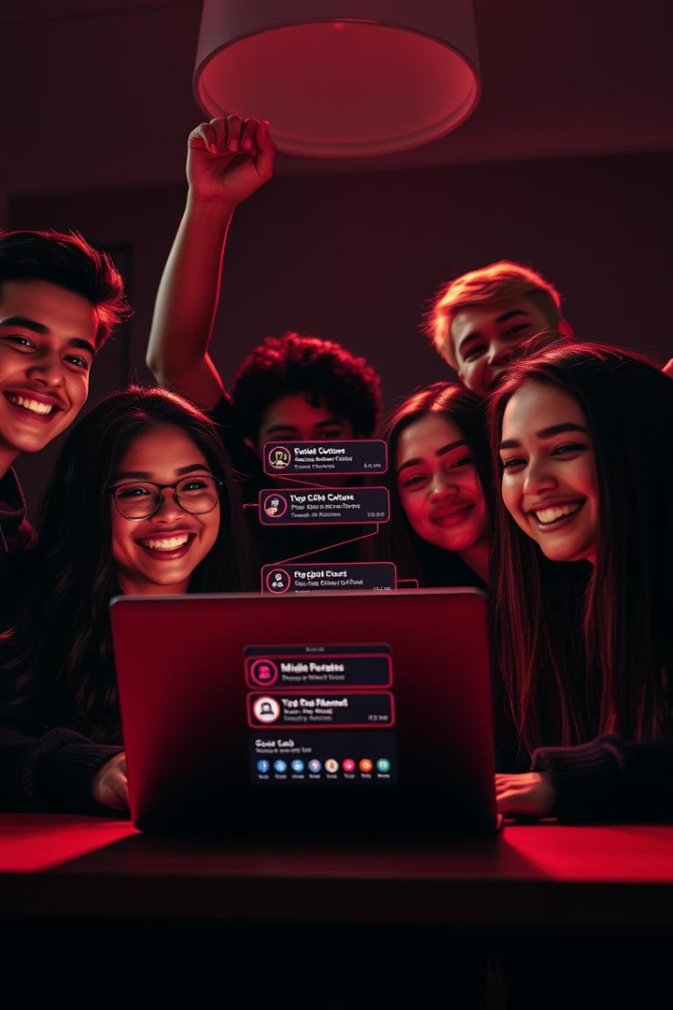
Thank You!
We appreciate your time and support.
Neo Nova aims to enhance smart academic assistance for students.
Notes:
10

